Slide 1
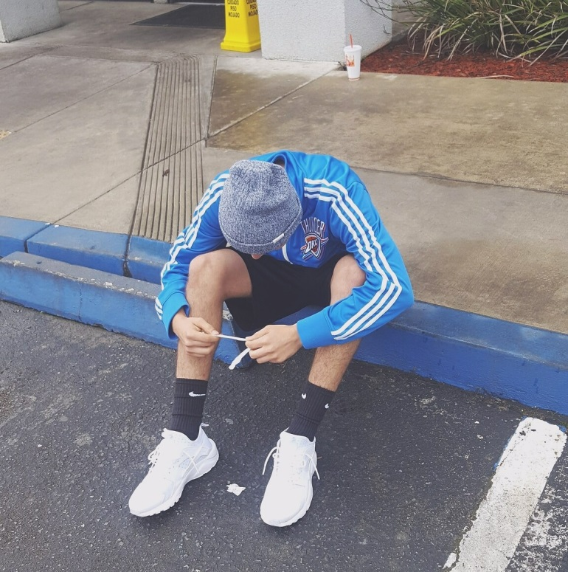
Angel Reyes
CLA$$ OF 2017

Slide 2
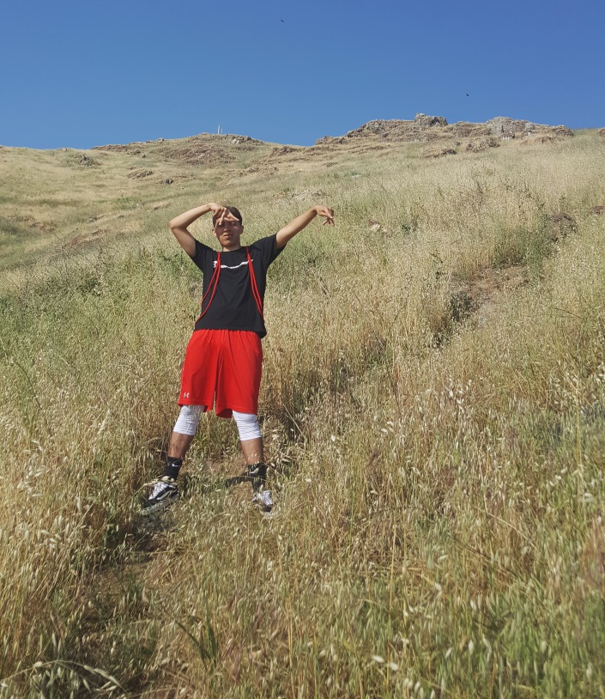
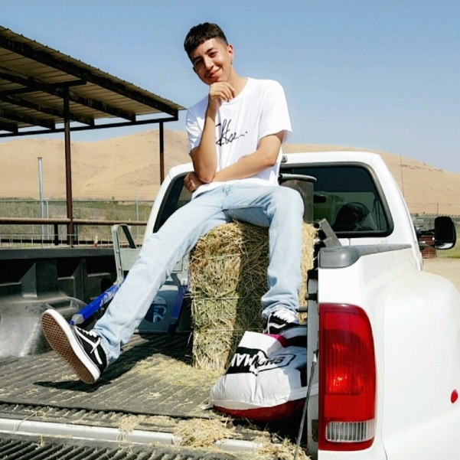
About Me
Born in Tecate, Baja California.
Trilingual
Have a part time job
Oldest of 3
Came to the US when I was 9
months
17 years old
Love music

Slide 3
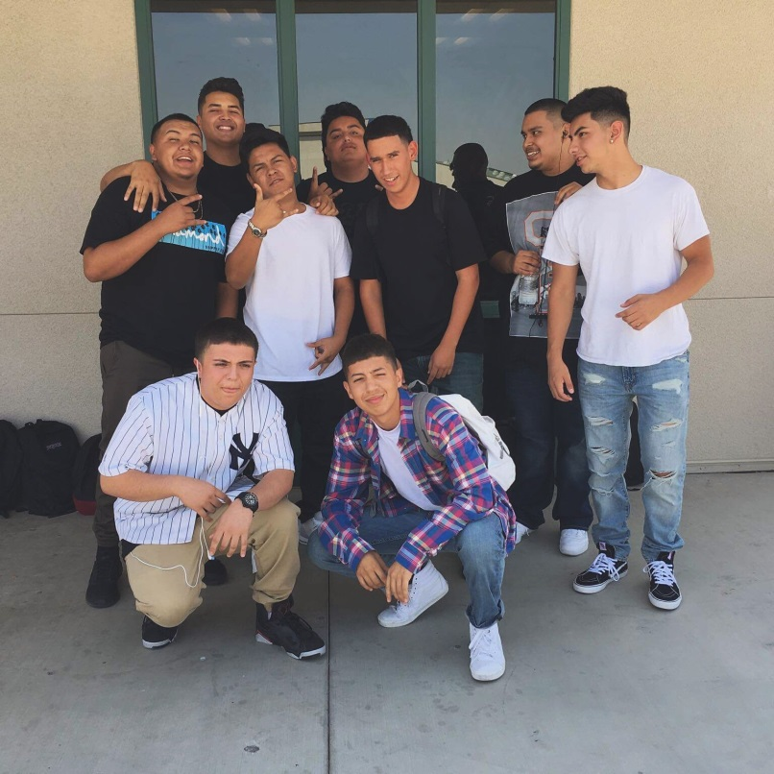
High School Experience
Played soccer freshmen year
Best 4 years of my life
Awesome learning facilitators
Made new friends
NATP program
PBS system allowed me to work
at my own pace

Slide 4
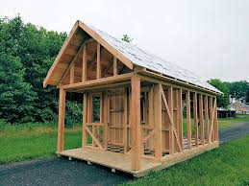
Pathway
Residential Construction
Chose it because it got my
attention
Doesn't relate to what I
have planned for the future
but will definitely come in
handy having these skills
I've learned.

Slide 5
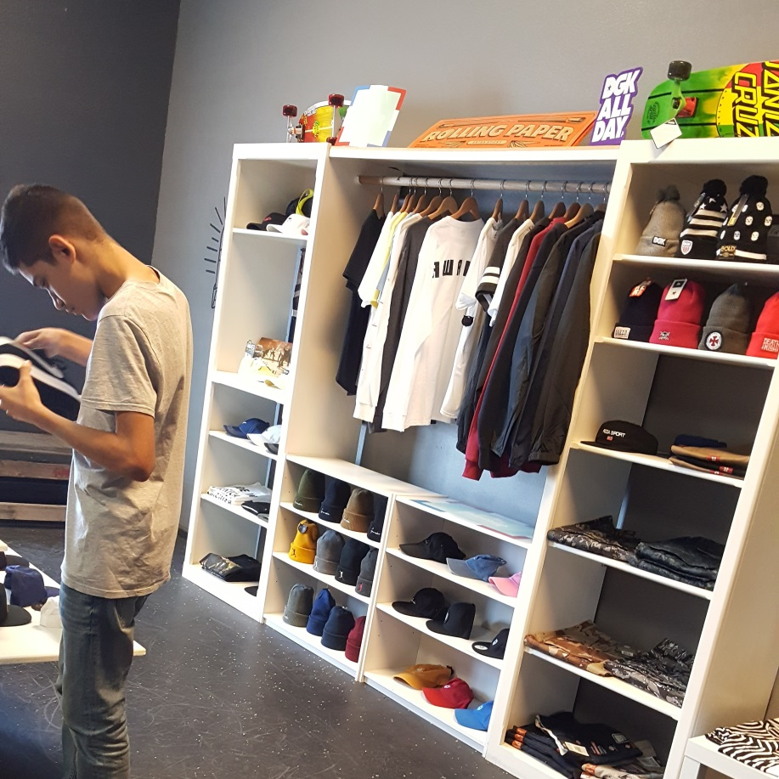
Job Shadow
Business owner
Awake Skate Shop
Interested in opening up a
clothing store
I see myself opening up
a store

Slide 6
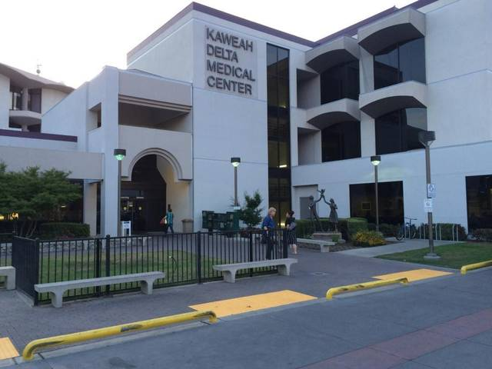
Post-High School Plans
Planning on becoming a CNA after I graduate
I want to help my family financially
Move out of my parents house
Long term goal/I want to be a
Physician Assistant
or Pediatric
Have a family
Grow old
Be happy

Slide 7
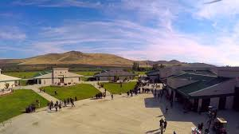
Leaving LHS
Going to miss LHS had one of the best high school experiences
LHS taught me to more responsible and dedicated
PBS taught me to be independent

Slide 8
Any Questions ?

